Slide 1

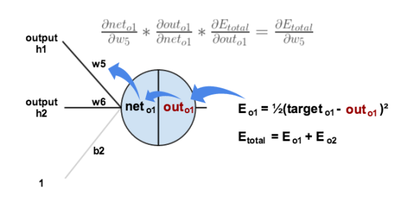



JA105 Part 2 Training a Multi-Layer Perceptron using the Error Back Propagation Algorithm Academic Year 2022-23
Prof. John Abela
Department of CIS
Faculty of ICT
University of Malta
john.abela@um.edu.mt
+ 365 79367936
Room 1A/27
FICT Building
©John Abela, 2018-2022
David Rumelhart
Faculty of
ICT
Geoffrey Hinton
Department of
Computer Information Systems
Last Updated
02-Oct-2022

Slide 2


Some notes about this Module
2
The purpose of this slide deck is to illustrate the implementation of a feed-forward multi-layer perceptron (MLP) that learns a 5 X 3 Boolean function.
The Multi-Layer Perceptron uses Error-Back Propagation as the training algorithm and Sigmoid as the transfer function in the hidden and output neurons.
The implementation is based on that described in Chapter 3 of the textbook by Philip D. Wasserman Neural Computing – Theory and Practice published by Van Nostrand Reinhold.
These slides continue from JA105 – Part 1.
The slides cover only concepts, techniques and recommendations for implementation. There is no code.
The slides are useful for students who want to learn how to implement such an MLP. The concepts and techniques can be applied to other MLP learning tasks in other domains.
The main idea put forward is that implementing such a Multi-Layer Perceptron basically involves only matrix and vector arithmetic.
Field | Value
Author | John Abela
Department | CIS
Version | 1.0d
Last Updated | 02-Nov-2020
Feedback | john.abela@um.edu.mt
Error Back Propagation

Slide 3
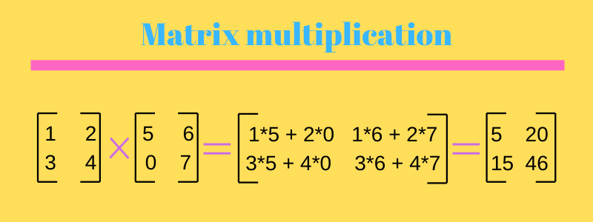
Important Notes
3
The MLP network used to demonstrate the error back propagation algorithm is exactly the same one as for the CIS3187 coursework.
Note that the coursework for CIS2350 is different.
We therefore discuss certain implementation issues.
It cannot be over-emphasized that implementing a multi-layer perceptron involves only matrix and vector arithmetic.
Note that material is examinable for both CIS3087 and CIS3187. This applies also for CIS2350.
Error Back Propagation

Slide 4

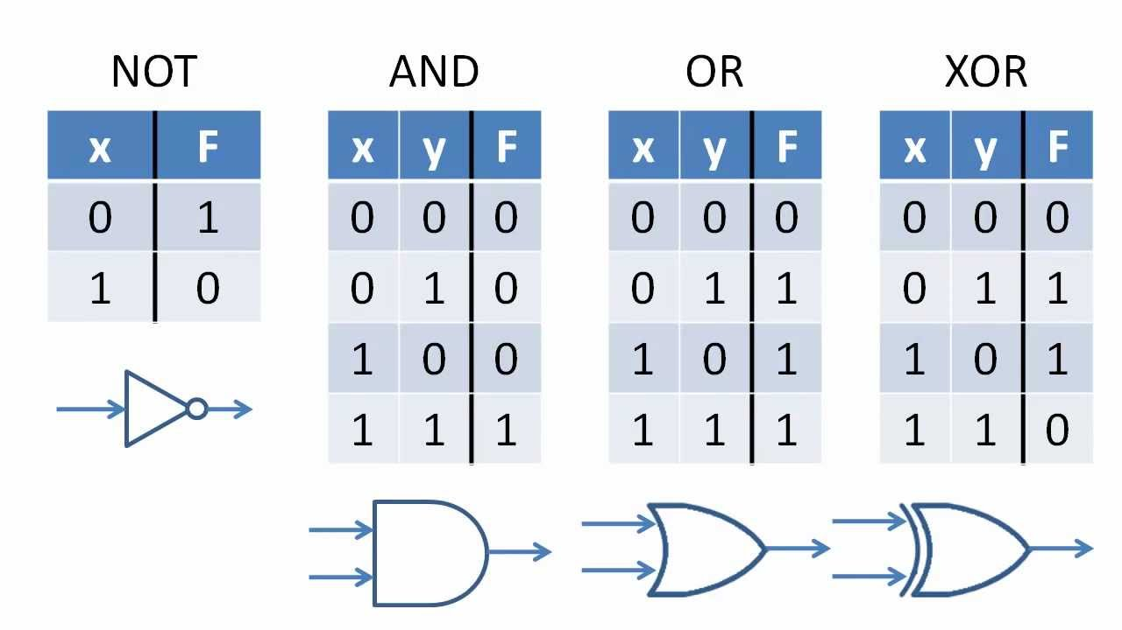
Old Coursework (SD Only pre-2021)
4
Remember
This is supervised learning. The training set must be labelled. This means that every training example must have an input and the expected output (called the target).
A training example is called the input-target pair or fact.
The Multi-Layer Perceptron uses the target to compute the error for every output neuron. The error is then used by the Error Back Propagation Algorithm (Backprop) to modify the weights.
Randomizing a training set in Excel is very easy
Add a new column and populate with random numbers using the =rand() function.
Sort all cells using the new column as the primary sort column.
Done!
Design ,and implement, a feed-forward artificial Multi-Layer Perceptron (MLP) that learns a Boolean function from training data.
A Boolean function is a function whose input and output are Boolean vectors. The vector components are bits: 0 or 1.
The Boolean function you must implement maps 5 input bits to 3 output bits.
Since there are 5 input bits the total number of possible inputs is 32 or 2⁵.
You can choose any 5 X 3 Boolean function you like.
Create the Boolean function in Excel and store as a CSV file.
80% of the input – target vector pairs will be used to train the MLP, 20% will be used for testing.
1
1
1
f
0
0
1
1
0
Error Back Propagation

Slide 5
Creating a Training Set
5
ABCDE
0 | 00000 | 110
1 | 00001 | 111
2 | 00010 | 010
3 | 00011 | 011
4 | 00100 | 100
5 | 00101 | 101
6 | 00110 | 110
7 | 00111 | 000
8 | 01000 | 001
9 | 01001 | 010
10 | 01010 | 011
11 | 01011 | 100
12 | 01100 | 101
13 | 01101 | 110
14 | 01110 | 000
15 | 01111 | 001
16 | 10000 | 010
17 | 10001 | 011
18 | 10010 | 100
19 | 10011 | 101
20 | 10100 | 110
21 | 10101 | 000
22 | 10110 | 001
23 | 10111 | 010
24 | 11000 | 011
25 | 11001 | 100
26 | 11010 | 101
27 | 11011 | 110
28 | 11100 | 000
29 | 11101 | 001
30 | 11110 | 010
31 | 11111 | 011
Create the Boolean function in Excel. You can use ANY 5 X 3 Boolean function you like.
An example of a Boolean function is ABCDE → ABD or ABCDE → CBE
Use 80% (26 out of 32) of the input-target pairs for training.
Use 20% (6 out of 32) of the input-target pairs for testing.
Recommended!
Store the training and testing sets separately as CSV files.
Each CSV file will contains input-target pairs
15,0,1,1,1,1,0,0,1
22,1,0,1,1,0,0,0,1
The input-target pairs in the training set file MUST BE in RANDOM order!
Error Back Propagation

Slide 6


Training the Multi-Layer Perceptron
6
0 | 00000 | 110
1 | 00001 | 111
2 | 00010 | 010
3 | 00011 | 011
4 | 00100 | 100
5 | 00101 | 101
6 | 00110 | 110
7 | 00111 | 000
8 | 01000 | 001
9 | 01001 | 010
10 | 01010 | 011
11 | 01011 | 100
12 | 01100 | 101
13 | 01101 | 110
14 | 01110 | 000
15 | 01111 | 001
16 | 10000 | 010
17 | 10001 | 011
18 | 10010 | 100
19 | 10011 | 101
20 | 10100 | 110
21 | 10101 | 000
22 | 10110 | 001
23 | 10111 | 010
24 | 11000 | 011
25 | 11001 | 100
26 | 11010 | 101
27 | 11011 | 110
28 | 11100 | 000
29 | 11101 | 001
30 | 11110 | 010
31 | 11111 | 011
The objective of training is for the Multi-Layer Perceptron to learn our Boolean function.
The network will be trained on the 26 (80%) training examples in the hope that it will then ‘guess’ the correct output for the 6 (20%) testing examples.
Training involves finding a set of weights that will classify the testing examples correctly.
When a Multi-Layer Perceptron is trained the topology and architecture (layers, number of neurons, etc.) does not change. All that training does is to find a set of weights that implements the function that is being learnt.
Finding a set of weights for a Multi-Layer Perceptron is not straightforward or trivial. In fact, it is NP-Hard.
We use the Error Back-Propagation Algorithm to find a set of weights that correctly classify the training set.
We then hope that these weights will also classify correctly the testing examples.
🅽🅿-🅷🅰🆁🅳
Error Back Propagation

Slide 7
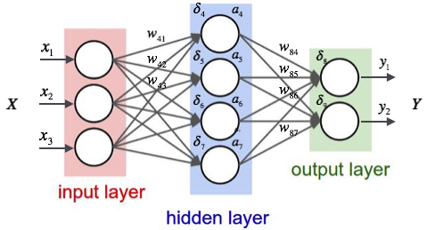
7
Multi-Layer Perceptron Structure
In a typical MLP, the neurons are organized in layers.
The first layer is the input layer followed by 1 or more hidden layers and then the output layer.
Data flow is from the inputs X_{i} to the outputs Y_{i}.
Each neuron in every layer, except the output layer, is connected to every neuron in the next layer.
Associated with each connection is a weight. A weight is positive or negative real number.
Each neuron in every layer, except the input layer accepts the outputs of the neurons in the previous layer as inputs.
Error Back Propagation

Slide 8
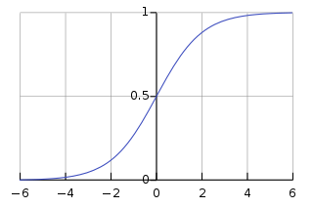

Multi-Layer Perceptron Topology
8
The Multi-Layer Perceptron topology is the architecture of the MLP. The means:
The number of layers and the number of neurons in each layer.
The connections between the neurons and their direction.
The transfer function used for the neurons.
In our Multi-Layer Perceptron:
There are 3 layers – input (i), hidden (j), and output (k)
The number of neurons in each layer is:
input – 5, hidden - 4, and output – 3.
The input layer neurons are identity neurons – denoted by a square. They just copy the input to the output.
The transfer function for the hidden and output neurons is the sigmoid function.
This is a feed-forward network so the direction of the connections (weights) is always forward – from input to output.
f
f
f
f
f
f
f
k
output
j
hidden
i
input
$$f(x)=\frac{1}{1+e^{−x}}$$
Error Back Propagation

Slide 9
Multi-Layer Perceptron Learning Parmeters
9
The algorithm we will use to train the Multi-Layer Perceptron requires 2 parameters:
The Learning Rate η (Greek letter eta) This is a real number between 0 and 1 usually set to 0.2. Used to determine how much of the neuron error is used to modify the weights.
The Error Threshold μ (Greek letter mu) This is a real number between 0 and 1 usually set to 0.2. Used to determine how much of the neuron error ‘leeway’ is given to the output layer neurons.
Other parameters may include the max number of epochs.
f
f
f
f
f
f
f
i
input
j
hidden
k
output
Error Back Propagation

Slide 10
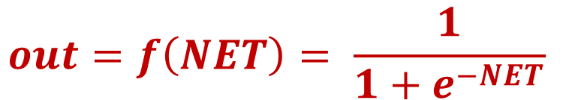

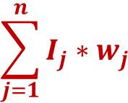
10
An Artificial Neuron
Input I₁
w₁
An artificial neuron is a device with many inputs and one output. The n inputs and the output are real numbers.
Associated with every input I_{j} is a weight w_{j}. Weights are also real numbers.
The neuron has two processing units. The summation (or summing) unit and the transfer (activation) function.
The summation unit multiplies each input by its connection weight and then adds the products. This produces the value NET.
The output of the neuron is f(NET) where f() is the transfer function.
Input I₂
w₂
Input I₃
w₃
$$\sum_{j=1}^{n}{I_{j}∗w_{j}}$$
f
Input I₄
w₄
…
w_{j}
out
Input I_{j}
…
w_{n}
NET
Input I_{n}
$$NET=\sum_{j=0}^{n}{I_{j}∗w_{j}}$$
$$out=f\left(NET\right)= \frac{1}{1+e^{−NET}}$$
Error Back Propagation

Slide 11






Multi-Layer Perceptron Training
0 | 00000 | 110
1 | 00001 | 111
2 | 00010 | 010
3 | 00011 | 011
4 | 00100 | 100
5 | 00101 | 101
6 | 00110 | 110
7 | 00111 | 000
8 | 01000 | 001
9 | 01001 | 010
10 | 01010 | 011
11 | 01011 | 100
12 | 01100 | 101
13 | 01101 | 110
14 | 01110 | 000
15 | 01111 | 001
16 | 10000 | 010
17 | 10001 | 011
18 | 10010 | 100
19 | 10011 | 101
20 | 10100 | 110
21 | 10101 | 000
22 | 10110 | 001
23 | 10111 | 010
24 | 11000 | 011
25 | 11001 | 100
26 | 11010 | 101
27 | 11011 | 110
28 | 11100 | 000
29 | 11101 | 001
30 | 11110 | 010
31 | 11111 | 011
Fact 18
1 | 0 | 0 | 1 | 0
1 | 0 | 0
i
input
j
hidden
k
output
1
f
Output
Target
Error
0
f
0.821
1
0.179
0
0.619
0
-0.619
1
0.341
0
-0.341
0
Error
Back Propagation
Algorithm
Perform Feed Forward on the input (vector) to produce the output (vector)
Error Back Propagation

Slide 12
Feed Forward –Simple Vector/Matrix Arithmetic
12
Feed Forward means producing a network output for a given input. Input example (or fact) 1,0,0,1,1,0,0,1
input[] X wH[] = netH[]
Use sigmoid() to produce outH[] from netH[]
outH[] X wO[] = netO[]
Use sigmoid() to produce outO[]
1
f
Output
Target
Error
0
f
0.451
0
-0.451
0
0.619
0
-0.619
1
0.821
1
0.179
k
output
1
j
hidden
i
input
wO[]
input[]
5
wH[]
4
netH[]
4
3
netO[]
3
target[]
3
1
1 | 0 | 0 | 1 | 1
1
1
1
outH[]
4
4
outO[]
3
error[]
3
5
1
1
1
Error Back Propagation

Slide 13
Feed Forward - Notes
13
Feed Forward produces an output (in each of the 3 neurons in the output layer) when an input is presented to the network.
Feed Forward is super easy (when you understand it).
Feed Forward involves ONLY vector and matrix arithmetic and passing vector components through the sigmoid() function.
When learning starts the weights are randomly initialized to real numbers between -1 and 1.
When training starts the network will usually produce large errors.
The errors are used by the Error Back Propagation algorithm to modify the weights.
An epoch is when all training examples are passed through the network.
Training usually requires many epochs (hundreds or thousands).
Error Back Propagation

Slide 14
Multi-Layer Perceptron Training - Notes
14
For every epoch you must keep track of the good facts and the bad facts.
A good fact is when a training example is presented to the network, feed forward is used to produce the network output and all neurons in the output layer have an error (Target-out) less than or equal to the Error Threshold μ (Greek letter mu) – usually set to 0.2
A bad fact is when a training example is presented to the network, feed forward is used to produce the network output and at least one neuron in the output layer has an error (Target-out) greater than Error Threshold μ (Greek letter mu) – usually set to 0.2
The bad facts are plotted against the epochs in a graph. Note that Multi-Layer Perceptron learning is non-monotonic.
Error Back Propagation

Slide 15
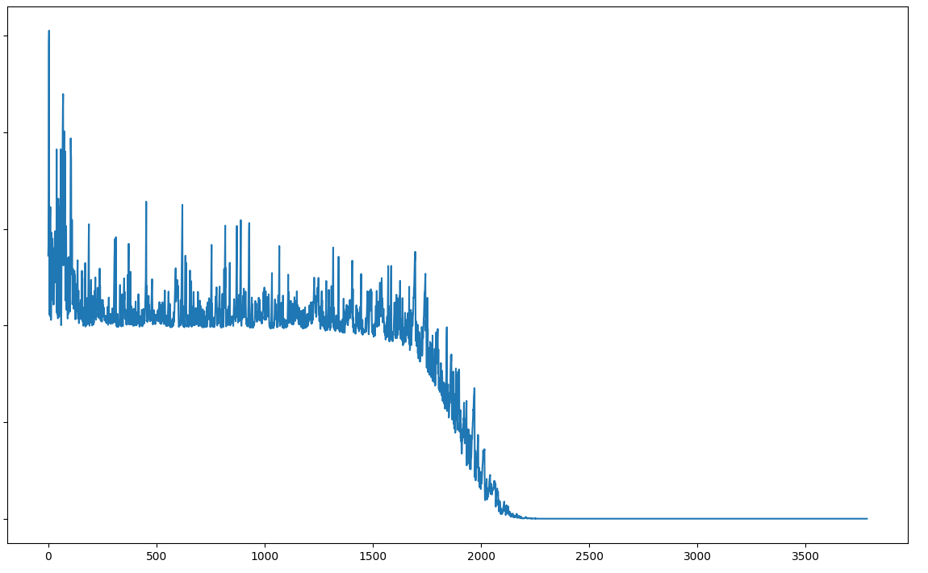
Bad Facts – Epochs Graph
15
100%
Non-monotonic
0%
Error Back Propagation

Slide 16
Error Back Propagation - Output Layer Weights
16
Compute the δ value for each of the outer layer neurons.
Change the output layer weights using the following equation
Δw_{pq,k} = η δ_{q,k} OUT_{p,j}
w_{pq,k} = w_{pq,k} + Δw_{pq,k}
where η = 0.2 is the learning rate.
You can easily implement this using two nested for loops.
i
input
j
hidden
k
output
Delta δ
Output
Target
Error
0.2631
0.821
1
0.179
p
q
-0.146
0.619
0
-0.619
-0.0767
0.341
0
-0.341
Sigmoid Derivative
Error
w_{pq,k}
δ = OUT(1-OUT)(Target-OUT)
→ 0.821*(1-0.821)*(1 – 0.821)
→ 0.02631
Error Back Propagation

Slide 17
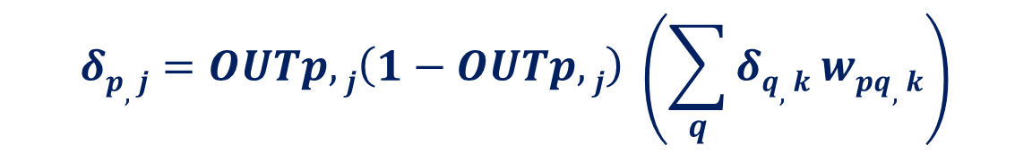
Error Back Propagation – Hidden Layer δs
17
i
input
j
hidden
Compute the δ value for each of the hidden layer neurons.
This is somewhat more complex than for the outer layer neurons.
Use the equation as in the Wasserman book (reproduced below)
Make sure you get the loop indices right.
k
output
Delta δ
Output
Target
Error
0.2631
0.821
1
0.179
p
q
-0.146
0.619
0
-0.619
-0.0767
0.341
0
-0.341
$$δp,j=OUTp,j\left(1−OUTp,j\right) \left(\sum_{q}{δq,k wpq,k}\right)$$
Error Back Propagation

Slide 18
Error Back Propagation - Hidden Layer Weights
18
Compute the δ value for each of the hidden layer neurons.
Change the hidden layer weights using the following equation
Δw_{pq,j} = η δ_{q,j} OUT_{p,i}
w_{pq,j} = w_{pq,j} + Δw_{pq,j}
where η = 0.2 is the learning rate.
Again, you can easily implement this using two nested for loops.
i
input
j
hidden
k
output
δ_{j1}
Delta δ
Output
Target
Error
p
0.2631
0.821
1
0.179
q
δ_{j2}
-0.146
0.619
0
-0.619
δ_{j3}
-0.0767
0.341
0
-0.341
δ_{j4}
Error Back Propagation

Slide 19
BackProp – Simple Vector/Matrix Arithmetic
19
After computing the δs of the outer layer use 2 nested loops to change the output layer weights.
Then compute the hidden layer δs and store in deltaH[].
Use 2 nested loops to change the weights of the hidden layer.
1
f
Output
Target
Error
0
f
0.451
0
-0.451
0
0.619
0
-0.619
1
0.821
1
0.179
k
output
1
j
hidden
target[]
3
i
input
1
wO[]
input[]
5
wH[]
4
netH[]
4
3
netO[]
3
error[]
3
1
1 | 0 | 0 | 1 | 1
1
1
1
outH[]
4
outO[]
3
deltaO[]
3
1
4
1
1
5
deltaH[]
4
1
Error Back Propagation

Slide 20



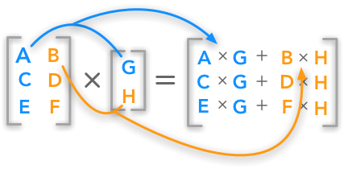
Why does Error BackProp Stress Students Out?
20
Implementing Error BackProp is relatively simple.
It involves only vector and matrix arithmetic.
Then why does it stress students out so much?
Because it is very bug sensitive.
Even the smallest bug makes it fail.
You have to be very careful with the code.
Do not blame the compiler – check the code.
I hate
Error Back Propagation!

Slide 21

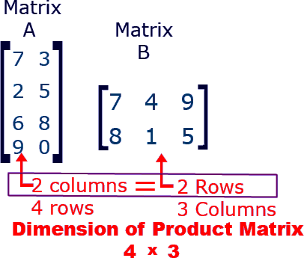
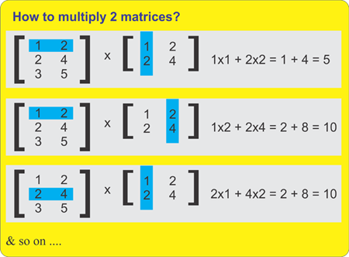
Matrix Arithmetic
21
Baby
Shark
You can multiply two matrices A and B only if A_{Columns} is equal to B_{Rows}.
The size of the product matrix will be A_{Rows} by B_{Columns}.
Then compute the product using the dot product of rows and columns.
This a baby level arithmetic. If you get stuck ask a baby.

Slide 22
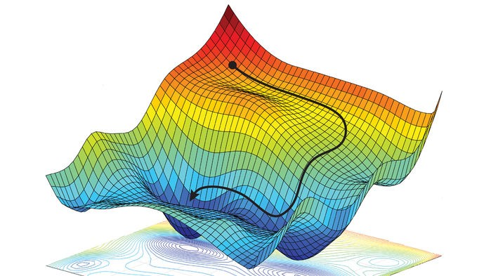
Error Back Propagation is Gradient Descent
I
Suppose you have a neural network with just 2 weights – w₁ and w₂.
Suppose you take all possible discrete values of w₁ and w₂ and you plot the output error of the neural network as a surface plot.
This results in an ‘error surface’.
Backprop tries to find the area with the lowest error.
This is called gradient descent.
Given starting values of w₁ and w₂, the algorithm works it way ‘downhill’ to the area of lowest error.
w₁
∑
f
Output
w₂
I

Slide 23
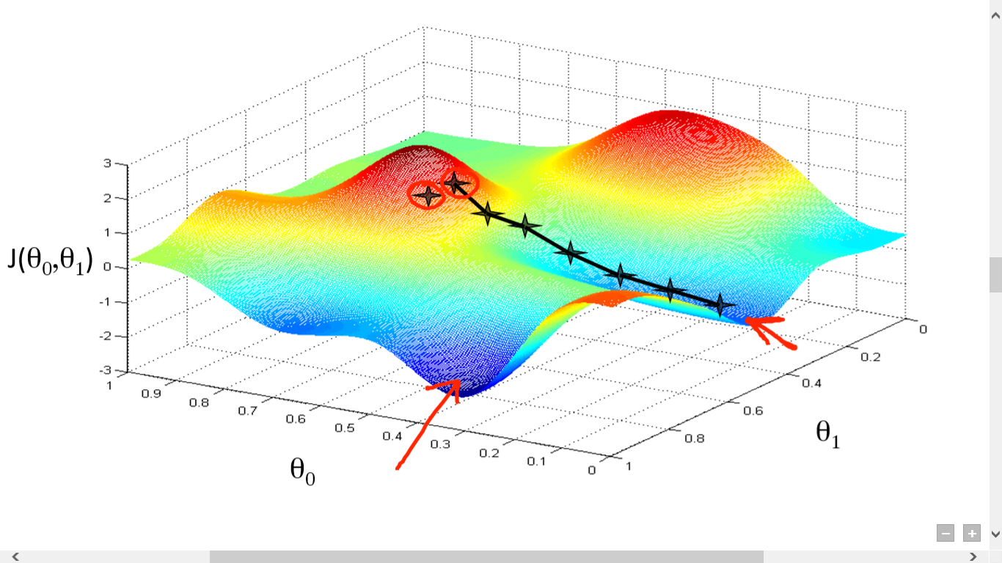
The Principle behind Gradient Descent
23
I
θ₀
∑
f
Output
θ ₁
I

Slide 24

Multi-Layer Perceptron Training – Final Notes
24
You must keep on repeating epochs until you get an epoch with no bad facts. This means that you (feed forward) a whole epoch (all training examples) and all training examples produce an output with an error less than or equal to the error threshold for all 3 output neurons.
You may need tens, hundreds, or thousands of epochs.
Initially keep the error threshold and learning rate at 0.2
You must then pass the 6 testing examples through the network (feed forward only – no back propagation) and record the results.
Remember the bad facts vs epochs graph as shown, and discussed, earlier.

